Slide 1
Dynamics and Actions
Logic for Artificial Intelligence
Yi Zhou

Slide 2
  Content
    Dealing with dynamics
    Production rules and subsumption architecture
    Situational calculus and AI planning
    Markov decision process
    Conclusion

Slide 3
  Content
    Dealing with dynamics
    Production rules and subsumption architecture
    Situational calculus and AI planning
    Markov decision process
    Conclusion

Slide 4
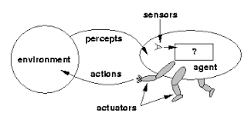
Need for Reasoning about Actions
The world is dynamic
Agent needs to do actions
Programs are actions

Slide 5
  Content
    Dealing with dynamics
    Production rules and subsumption architecture
    Situational calculus and AI planning
    Markov decision process
    Conclusion

Slide 6
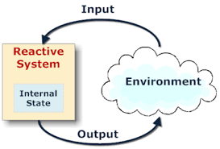
Production rules
If condition then action

Slide 7
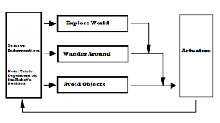
Subsumption Architecture

Slide 8
  Content
    Dealing with dynamics
    Production rules and subsumption architecture
    Situational calculus and AI planning
    Markov decision process
    Conclusion

Slide 9
Formalizing Actions
Pre-condition action Post-condition
Pre-condition: conditions that hold before the action
Post-condition: conditions that hold after the action
Pre-requisites: conditions that must hold in order to execute the action
Pre-condition vs Pre-requisites
temp>20 vs temp is working

Slide 10
Situations,Actions and Fluents
On(A,B) A is on B (eternally)
On(A,B,S0) A is om B in situation S0
Holds(On(A,B),S0) On(A,B) ”holds” in situation S0
On(A,B) is called a Fluent
Holds is s ”meta predicate”
A fluent is a situation dependent predication.
A situation or state may either be a
start state e.g.
S= S0, or
the result of applying an action A in a state S
S2 = do(S1,A)

Slide 11
Situation Calculus Notations
Clear(u,s) ➔ Holds(Clear(u),s)
On(x,y,s) ➔ Holds(On(x,y),s)
Holds metapredicate
On(x,y) Fluent
S State
Negative Effect axioms /Frame axioms are default
(negation as failure)

Slide 12
SitCalc examples
Actions :
move(A,B,C) move block A from B to C
Fluents:
On(A,B) A is on B
Clear(A) A is clear
Predications:
Holds(Clear(A),S0) A is clear in start state S0
Holds(On(A,B),S0) A is on B in S0
Holds(On(A,C),do(S0,move(A,B,C))) A is on C after move(A,B,C) is
done in S0
Holds(Clear(A),do(S0,move(A,B,C))) A is (still) clear after moving
move(A,B,C) in S0

Slide 13
Composite actions
Holds(On(B,C),
do(do(S0,move(A,B,Table),move(B,C))))
B is on C after starting in S0, and doing
move(A,B,Table) , move(B,C)
Alternative representation
Holds(PlanResult( [move(A,B),move(B,C)], S0)

Slide 14
Using Resolution to find plan
We can verify
Holds(On(B,C),
do(do(S0,move(A,B,Table),move(B,C))))
But we can also find a plan
?- Holds(On(B,C),X).
➔
X =do(do(S0,move(A,B,Table),move(B,C))))

Slide 15
Frame, Ramification, Quantification
Frame problem:
what will remain unchanged after the action?
Ramification problem:
what will be implicitly changed after the action?
Quantification problem:
how many pre-requisites for an action?

Slide 16
AI Planning Languages
Languages must represent..
  States
  Goals
  Actions
Languages must be
  Expressive for ease of representation
  Flexible for manipulation by algorithms

Slide 17
State Representation
A state is represented with a conjunction of positive literals
Using
  Logical Propositions: Poor ∧ Unknown
  FOL literals: At(Plane1,OMA) ∧ At(Plan2,JFK)
FOL literals must be ground & function-free
  Not allowed: At(x,y) or At(Father(Fred),Sydney)
Closed World Assumption
  What is not stated are assumed false

Slide 18
Goal Representation
Goal is a partially specified state
A proposition satisfies a goal if it contains all the atoms of the goal and possibly others..
  Example: Rich ∧ Famous ∧ Miserable satisfies the goal Rich ∧ Famous

Slide 19
Action Representation
At(WHI,LNK),Plane(WHI), Airport(LNK), Airport(OHA)
Action Schema
  Action name
  Preconditions
  Effects
Example
  Action(Fly(p,from,to),
  PRECOND: At(p,from) ∧ Plane(p) ∧ Airport(from) ∧ Airport(to)
  EFFECT: ¬At(p,from) ∧ At(p,to))
Sometimes, Effects are split into ADD list and DELETE list
Fly(WHI,LNK,OHA)
At(WHI,OHA), ¬ At(WHI,LNK)

Slide 20
Applying an Action
Find a substitution list θ for the variables
  of all the precondition literals
  with (a subset of) the literals in the current state description
Apply the substitution to the propositions in the effect list
Add the result to the current state description to generate the new state
Example:
  Current state: At(P1,JFK) ∧ At(P2,SFO) ∧ Plane(P1) ∧ Plane(P2) ∧ Airport(JFK) ∧ Airport(SFO)
  It satisfies the precondition with θ={p/P1,from/JFK, to/SFO)
  Thus the action Fly(P1,JFK,SFO) is applicable
  The new current state is: At(P1,SFO) ∧ At(P2,SFO) ∧ Plane(P1) ∧ Plane(P2) ∧ Airport(JFK) ∧ Airport(SFO)

Slide 21
Languages for Planning Problems
STRIPS
  Stanford Research Institute Problem Solver
  Historically important
ADL
  Action Description Languages
  See Table 11.1 for STRIPS versus ADL
PDDL
  Planning Domain Definition Language
  Revised & enhanced for the needs of the International Planning Competition
  Currently version 3.1

Slide 22
State-Space Search (1)
Search the space of states (first chapters)
  Initial state, goal test, step cost, etc.
  Actions are the transitions between state
Actions are invertible (why?)
  Move forward from the initial state: Forward State-Space Search or Progression Planning
  Move backward from goal state: Backward State-Space Search or Regression Planning

Slide 23
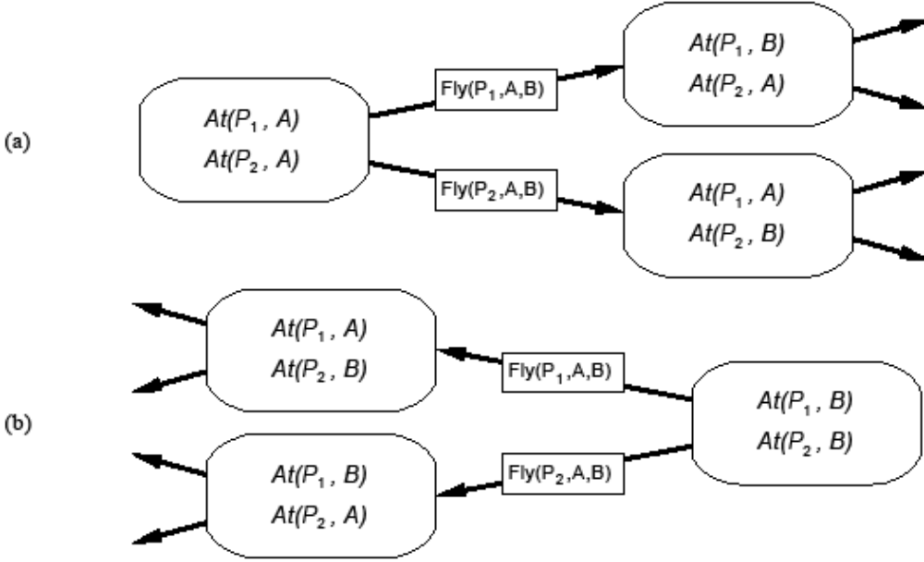
State-Space Search (2)

Slide 24
State-Space Search (3)
Remember that the language has no functions symbols
Thus number of states is finite
And we can use any complete search algorithm (e.g., A*)
  We need an admissible heuristic
  The solution is a path, a sequence of actions: total-order planning
Problem: Space and time complexity
  STRIPS-style planning is PSPACE-complete unless actions have
    only positive preconditions and
    only one literal effect

Slide 25
STRIPS in State-Space Search
STRIPS representation makes it easy to focus on ‘relevant’ propositions and
  Work backward from goal (using EFFECTS)
  Work forward from initial state (using PRECONDITIONS)
  Facilitating bidirectional search

Slide 26
Heuristic to Speed up Search
We can use A*, but we need an admissible heuristic
  Divide-and-conquer: sub-goal independence assumption
  Problem relaxation by removing
  … all preconditions
  … all preconditions and negative effects
  … negative effects only: Empty-Delete-List

Slide 27
Heuristic to Speed up Search
We can use A*, but we need an admissible heuristic
  Divide-and-conquer: sub-goal independence assumption
  Problem relaxation by removing
  … all preconditions
  … all preconditions and negative effects
  … negative effects only: Empty-Delete-List

Slide 28
Typical Planning Algorithms
Search
SatPlan, ASP plan
Partial-order plan
GraphPlan

Slide 29
AI Planning - Extensions
Disjunctive planning
Conformant planning
Temporal planning
Conditional planning
Probabilistic planning
… …

Slide 30
  Content
    Dealing with dynamics
    Production rules and subsumption architecture
    Situational calculus and AI planning
    Markov decision process
    Conclusion

Slide 31
Decision Theory
Probability Theory
+
Utility Theory
=
Decision Theory
Describes what an agent should believe based on evidence.
Describes what an agent wants.
Describes what an agent should do.
Notes:
MDPs fall under the blanket of decision theory

Slide 32
Markov Assumption
Andrei Markov (1913)
Markov Assumption:
The next state’s conditional probability depends only on a finite history of previous states
kth order Markov Process
Markov Assumption:
The next state’s conditional probability depends only on its immediately previous state
1st order Markov Process
The definitions are equivalent!!!
Any algorithm that makes the 1st order Markov Assumption can be applied to any Markov Process
Notes:
The Markov assumption

Slide 33
Markov Decision Process
The specification of a sequential decision problem for a fully observable environment that satisfies the Markov Assumption and yields additive costs.

Slide 34

Markov Decision Process
An MDP has:
A set of states S = {s₁ , s₂ , … s_{N}}
A set of actions A = {a₁ , a₂ , … a_{M}}
A real valued cost function g(s, a)
A transition probability function p(s’ | s, a)
Note:
We will assume the stationary Markov transition property. This states that the effect of an action is independent of time

Slide 35
Notation
k indexes discrete time
x_{k} is the state of the system at time k;
μ_{k}(x_{k}) is the control variable to be selected given the system is in state x_{k} at time k ; μ_{k} : S_{k} → A_{k}
π is a policy; π = {μ_{0,},..., μ_{N-1}}
π* is the optimal policy
N is the horizon, or number of times the control is applied
x_{k+1} = f(x_{k} , μ_{k}(x_{k}) ) k=0…N-1

Slide 36
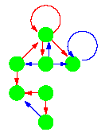
Policy
A policy is a mapping from states to actions
Following a policy:
1. Determine current state x_{k}
2. Execute action μ_{k}(x_{k})
3. Repeat 1-2

Slide 37
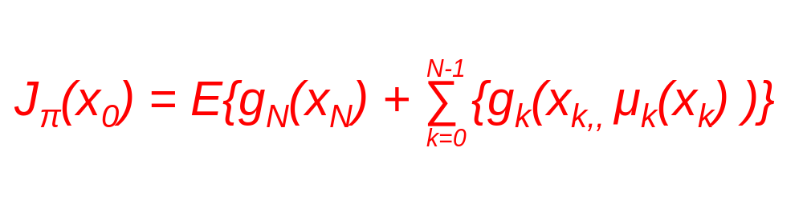
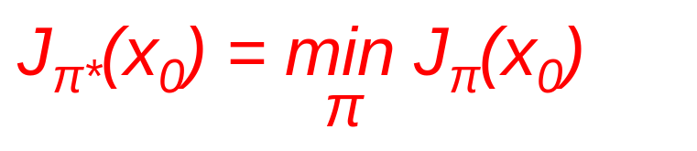
Solution to an MDP
The expected cost of a policy π = {μ_{0,},..., μ_{N-1}} starting at state x₀ is:
Goal: Find the policy π* which specifies which action to take in each state, so as to minimise the cost function.
This is encapsulated by Bellman’s Equation:
Notes:
A Markov Decision Process (MDP) is just like a Markov Chain, except the transition matrix depends on the action taken by the decision maker (agent) at each time step. The agent receives a reward, which depends on the action and the state. The goal is to find a function, called a policy, which specifies which action to take in each state, so as to maximize some function (e.g., the mean or expected discounted sum) of the sequence of rewards. One can formalize this in terms of Bellman's equation, which can be solved iteratively using policy iteration. The unique fixed point of this equation is the optimal policy.

Slide 38
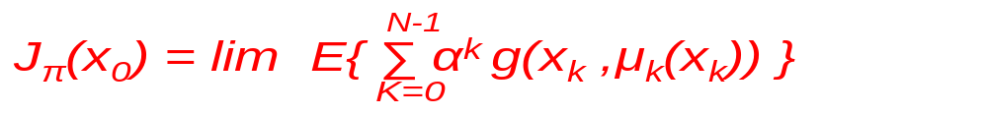
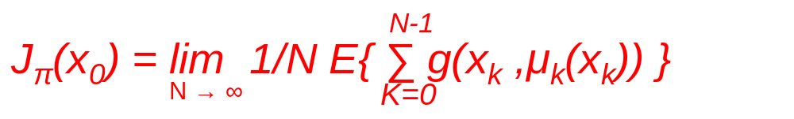
Assigning Costs to Sequences
The objective cost function maps infinite sequences of costs to single real numbers
Options:
Set a finite horizon and simply add the costs
If the horizon is infinite, i.e. N → ∞, some possibilities are:
  Discount to prefer earlier costs
  Average the cost per stage

Slide 39
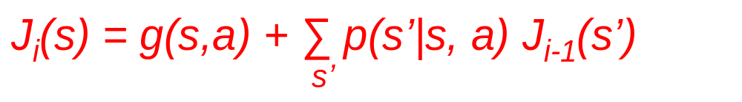
MDP Algorithms
Value Iteration
For each state select any initial value J_{o}(s)
k=1
while k < maximum iterations
For each state s find the action a that minimises the equation:
Then assign μ(s) = a
k = k+1
end

Slide 40

MDP Algorithms
Policy Iteration
Start with a randomly selected initial policy, then refine it repeatedly.
Value Determination: solve |S| simultaneous Bellman equations
Policy Improvement: for any state, if an action exists which reduces the current estimated cost, then change it in the policy.
Each step of Policy Iteration is computationally more expensive than Value Iteration. However Policy Iteration needs fewer steps to converge than Value Iteration.

Slide 41
  Content
    Dealing with dynamics
    Production rules and subsumption architecture
    Situational calculus and AI planning
    Markov decision process
    Conclusion

Slide 42
More approaches
  Decision theory, game theory
  Event calculus, fluent calculus
  POMDP
  Decision tree
  ……

Slide 43
Concluding Remarks
  Modeling dynamics and action selection is important
  Rule base approaches: production, subsumption architecture
  Classical logic based approaches: situation calculus, AI planning
  Probabilistic approaches: MDP, decision theory
  Game theoretical approaches

Slide 44

Thank you!

